Slide 1
My Mood
My Mood
The user is greeted with a Username and password login system
The user has a choice to Create a account
The user can even reset their password if they have forgotten it
The user can create an account by using a Username and password
If there are any errors an appropriate message will appear
They can use the back button to go and login after account creation
Username
Username
Password
Password
Login
Create Account
Forgot Password
Create Account

Slide 2

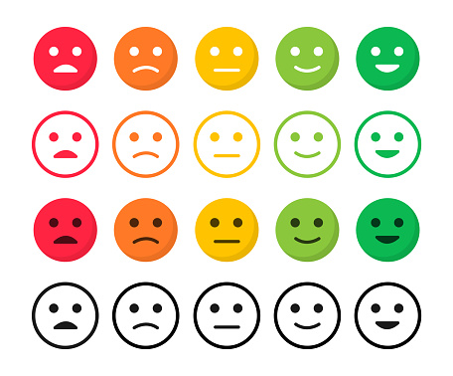


Todays Mood
On the first login of the day the user will be prompted with a mood selection panel
The use of simple symbols is for a more intuitive, user friendly experience
Once logged in and mood selection has been done, the main dashboard is shown
Currently there are 4 different tabs but more could be added in development
Mood History
Todays Notes
Past Days
My Account

Slide 3
Account
Mood Analytics
Mood Trends
Name
If the user selects “my account” they are shown their account details
These details can be changed by the user at any time
This is how they can also reset their password or log out the account
If mood analytics is selected they are prompted with different ways to see their data
All of these link to a separate state and will show data appropriately
DOB
Age
Quantities
Reset Password
Distributions
Log Out

Slide 4
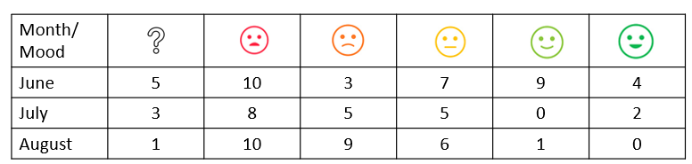
Mood Trends
Mood Trends
Time Period
Time Period
This page shows the trend of moods over a selected time period
The time period is selected using a drop down menu at the top
Appropriate data is shown in a line graph and a table for further analysis
This page shows the trend of moods over a selected time period
The time period is selected using a drop down menu at the top
Appropriate data is shown in a bar chart and a table for further analysis
100%
0%
June
July
August

Slide 5
Mood Trends
Todays Notes
Time Period
This page shows the trend of moods over a selected time period
The time period is selected using a drop down menu at the top
Appropriate data is shown in a pie chart and a table for further analysis
Text Here….
This page is where the user can add notes to each day
Specifically what affected their mood etc.
This can be updated at any time during the day of writing

Slide 6
Past Days
This page shows the old notes made per day
The user can select what day they would like to read upon and see the notes they made
This will also display the selected mood of the selected day
Notes cannot be changed on this menu
Date
This Days Mood
The Days Notes Displayed
Here

